Slide 1
NN BackPropagation
Bahaa El-Din Helmy

Slide 2
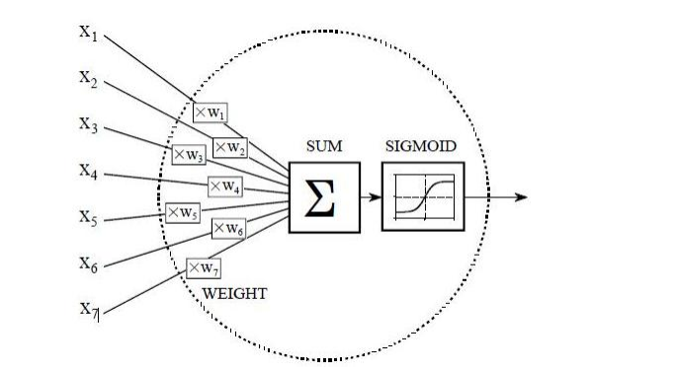
Back Propagation

Slide 3
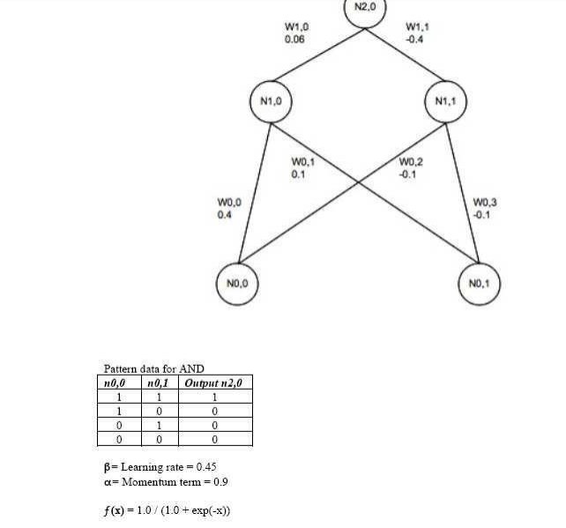

Slide 4
calculated. Sigmoid function is used for calculations f(x) = 1.0/(1.0 + exp(−x)).
N1, 0 = f(x1) = f(w0, 0 ∗ n0, 0 + w0, 1 ∗ n0, 1) = f(0.4 + 0.1) = f(0.5) = 0.622459
N1, 1 = f(x2) = f(w0, 2 ∗ n0, 0 + w0, 3 ∗ n0, 1) = f(−0.1 − 0.1) = f(−0.2) = 0.450166
When hidden layer values are calculated, network propagates forward, it propagates values from hidden layer up to a output layer node (N2,0). This is second step of feed forward computation
N2, 0 = f(x3) = f(w1, 0 ∗ n1, 0 + w1, 1 ∗ n1, 1) = f(0.06 ∗ 0.622459 + (−0.4) ∗ 0.450166) = f(−0.1427188) = 0.464381
Having calculated N2,0, forward pass is completed.

Slide 5
Back propagation to the output layer
Next step is to calculate error of N2,0 node.
From the table, output should be 1.
Predicted value (N2,0) in our example is 0.464381.
Error calculation is done the following way:
Once error is known, it will be used for backward propagation and weights adjustment.

Slide 6
t. It is two step process.
Error is propagated from output layer to the hidden layer first. This is where learning rate and momentum are brought to equation.
So weights W1,0 and W1,1 will be updated first. Before weights can be updated, rate of change needs to be found. This is done by multiplication of the learning rate, error value and node N1,0 value.
∆W1, 0 = β ∗ N2, 0Error ∗ n1, 0 = 0.45 ∗ 0.133225 ∗ 0.622459 = 0.037317
Now new weight for W1,0 can be calculated.
W1, 0New = w1, 0Old + ∆W1, 0 + (α ∗ ∆(t − 1)) =
0.06 + 0.037317 + 0.9 ∗ 0 = 0.097137
∆W1, 1 = β ∗ N2, 0Error ∗ n1, 1 =
0.45 ∗ 0.133225 ∗ 0.450166 = 0.026988
W1, 1New = w1, 1Old + ∆W1, 1 + (α ∗ ∆(t − 1)) =
−0.4 + 0.026988 = −0.373012

Slide 7
Back propagation to the hidden layer
N1, 0Error = N2, 0Error ∗ W1, 0N ew = 0.133225 ∗ 0.097317 = 0.012965
N1, 1Error = N2, 0Error ∗ W1, 1N ew = 0.133225 ∗ (−0.373012) = −0.049706

Slide 8
Once error for hidden layer nodes is known, weights between input and hidden layer can be updated.

Slide 9
Rate of change first needs to be calculated for every weight:
∆W0, 0 = β ∗ N1, 0Error ∗ N0.0 =
0.45 ∗ 0.012965 = 0.005834
∆W0, 1 = β ∗ N1, 0Error ∗ n0, 1 =
0.45 ∗ 0.012965 ∗ 1 = 0.005834
∆W0, 2 = β ∗ N1, 1Error ∗ n0, 0 =
0.45 ∗ −0.049706 ∗ 1 = −0.022368
∆W0, 3 = β ∗ N1, 1Error ∗ n0, 1 =
0.45 ∗ −0.049706 ∗ 1 = −0.022368

Slide 10
Than we calculate new weights between input and hidden layer.
W0, 0New = W0, 0Old + ∆W0, 0 + (α ∗ ∆(t − 1)) =
0.4 + 0.005834 + 0.9 ∗ 0 = 0.405834
W0, 1New = w0, 1Old + ∆W0, 1 + (α ∗ ∆(t − 1)) =
0.1 + 0.005834 + 0 = 0.105384
W0, 2New = w0, 2Old + ∆W0, 2 + (α ∗ ∆(t − 1)) =
−0.1 + −0.022368 + 0 = −0.122368
W0, 3New = w0, 3Old + ∗∆W0, 3 + (α ∗ ∆(t − 1)) = −0.1 + −0.022368 + 0 = −0.122368

